Slide 1



Air
Quality Insights
Exploring Benzene Levels in North Carolina

Slide 2

Topics Covered
Introduction
Goals of research
Agenda
Overview (Data, Visualizations and Findings)
Results
Our primary goal is to provide insights into the spatial-temporal distribution of benzene levels in North Carolina
Conclusion

Slide 3

INTRODUCTION

Slide 4
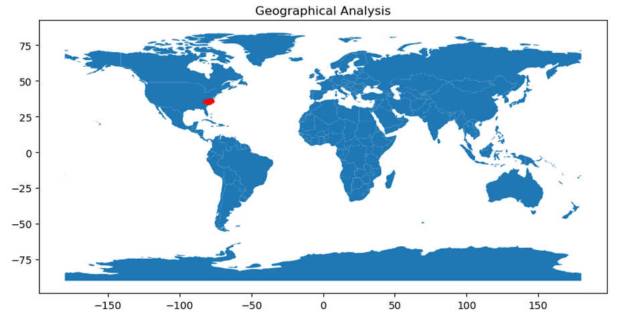
Benzene as a significant air pollutant
Benzene, a volatile organic compound, is a pervasive air pollutant in urban areas, stemming from industrial processes, vehicle emissions, and natural sources. Its presence poses grave health risks, including leukemia, respiratory issues, and developmental disorders. Understanding and monitoring benzene levels are vital for protecting public health and mitigating environmental damage. By implementing targeted interventions and raising awareness, communities can work towards cleaner, healthier urban environments.

Slide 5


GOALS OF RESEARCH

Slide 6
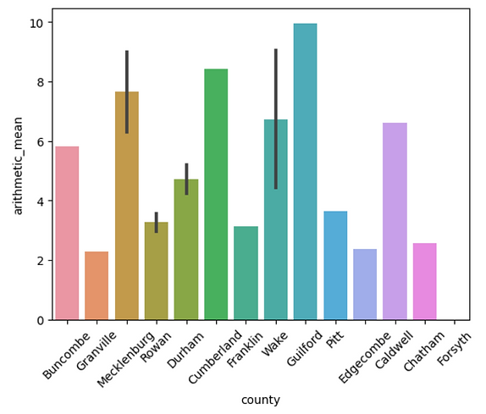
Insights into Air Pollution Dynamics and Predictive Modeling in North Carolina
Our research focuses on analyzing the temporal and spatial trends of benzene concentrations in North Carolina to understand air pollution dynamics in urban environments. By studying data patterns over time and space, we aim to identify the factors driving benzene emissions and their distribution across different regions of the state. Through this analysis, we seek insights into key variables such as industrial activity, vehicular emissions, meteorological conditions, and urban development, crucial for developing targeted interventions to mitigate benzene exposure and protect public health, particularly in vulnerable communities.
Additionally, our research aims to develop predictive models leveraging advanced statistical and machine learning techniques to forecast benzene concentrations based on various influencing factors. These models serve as decision-support tools for policymakers, urban planners, and public health officials, enabling evidence-based policy formulation and intervention strategies. Our target audience includes policymakers, urban planners, public health officials, and the general public, benefiting from our research insights to address air pollution challenges and raise awareness about environmental health concerns.

Slide 7
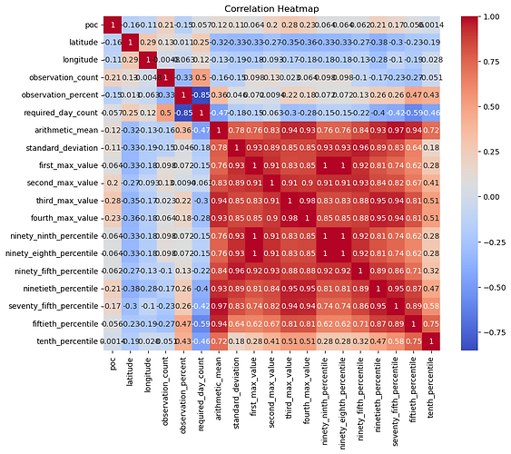
DATA OVERVIEW
Explore benzene trends in North Carolina's cities using EPA data, revealing insights through detailed analysis.

Slide 8
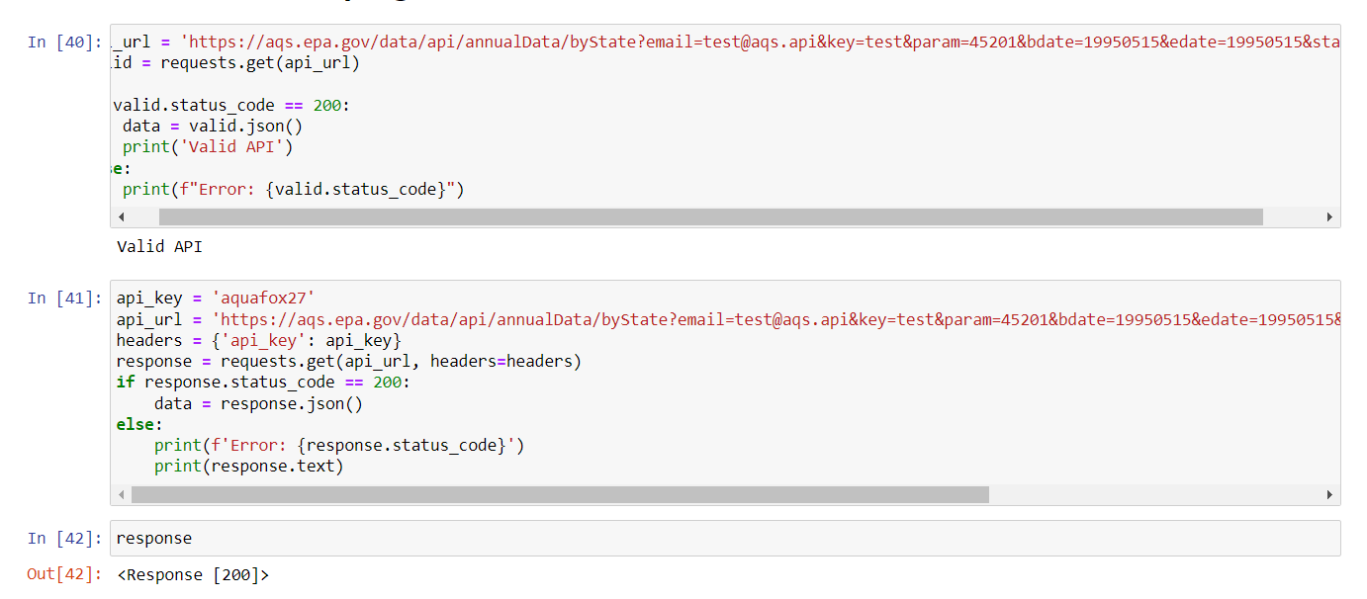
Urban Benzene Analysis in North Carolina
The dataset utilized for our analysis originates from the Environmental Protection Agency's (EPA) Air Quality System (AQS) API, a comprehensive repository of air quality data collected from monitoring stations across the United States. This rich dataset serves as a cornerstone for our research, offering a robust foundation for exploring benzene concentrations in North Carolina's urban areas.

Slide 9
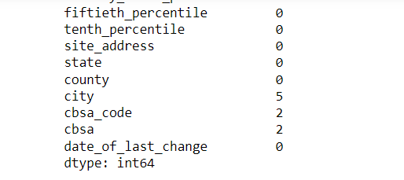
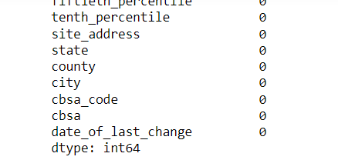

Slide 10
In its raw form, the dataset encompasses a wide array of variables, including geographical coordinates, temporal data, and benzene concentrations. Geographical coordinates provide precise location information for each monitoring station, enabling spatial analysis to identify hotspots and trends in benzene levels across different regions. Temporal data, such as timestamps and date ranges, allow us to investigate temporal patterns and fluctuations in benzene concentrations over time, providing valuable insights into seasonal variations and long-term trends.
The dataset underwent thorough cleaning, including removing duplicates, addressing missing values, and standardizing formats, ensuring reliable results in our study of urban air quality and benzene concentrations in North Carolina.

Slide 11
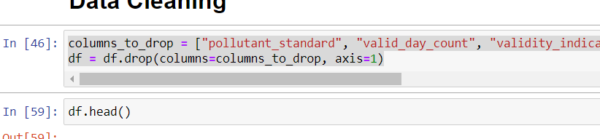
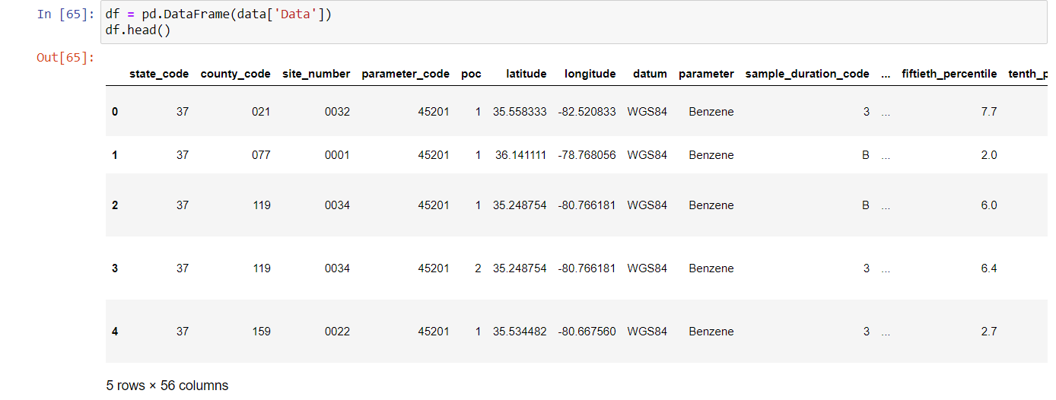

Slide 12
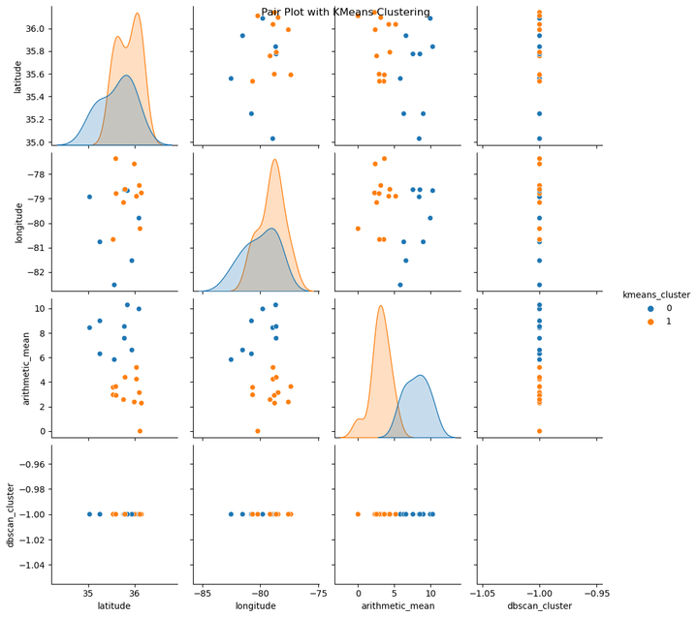
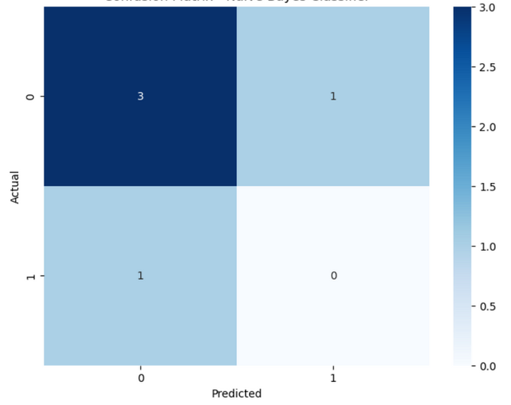
RESULTS AND FINDINGS
Unveiling Spatial Dynamics: Clustering Analysis of Benzene Concentrations in North Carolina
From Prediction to Policy: Insights from Modeling, Trends, and Justice Implications in Urban Air Quality

Slide 13
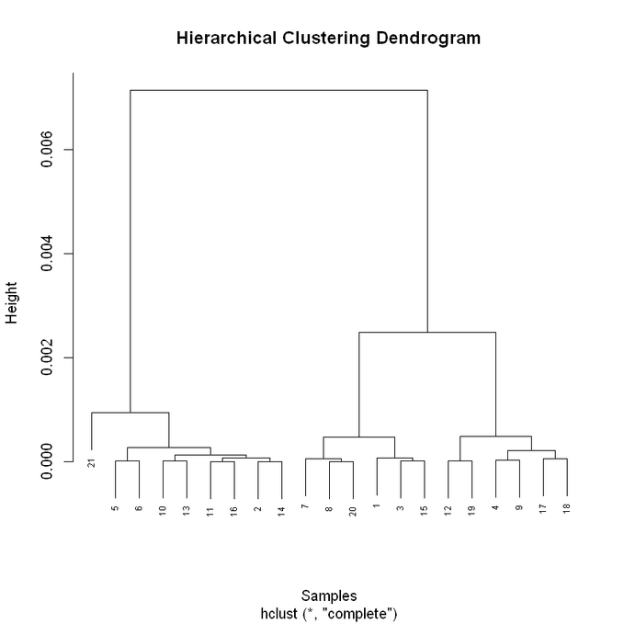
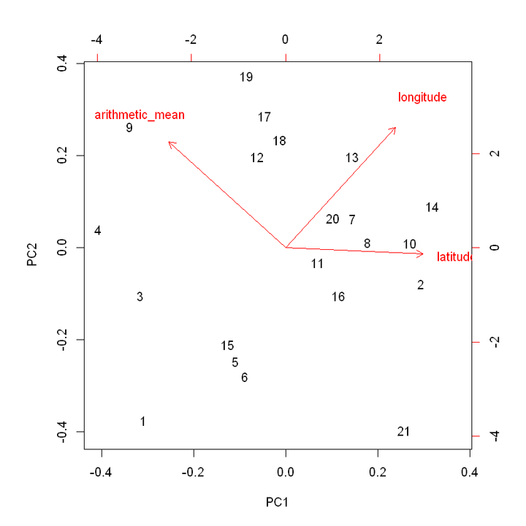
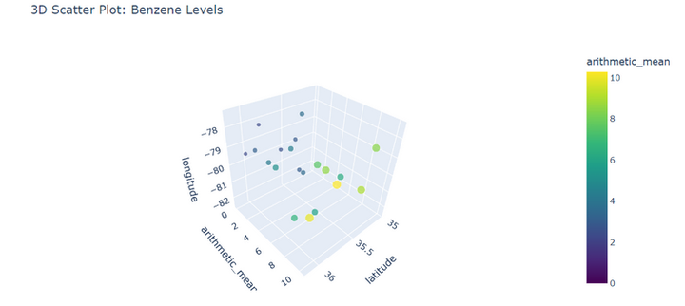
Spatial Patterns of Benzene Concentrations:
Clustering analysis, particularly K-Means and DBSCAN, revealed distinct spatial patterns in benzene concentrations across North Carolina. K-Means clustering identified clusters of high and low benzene levels, indicating spatial heterogeneity in air quality. DBSCAN, on the other hand, identified dense urban areas with elevated benzene concentrations and isolated rural areas with lower levels. These insights shed light on the spatial distribution of pollution sources and can inform targeted mitigation strategies for improving air quality in affected regions.

Slide 14
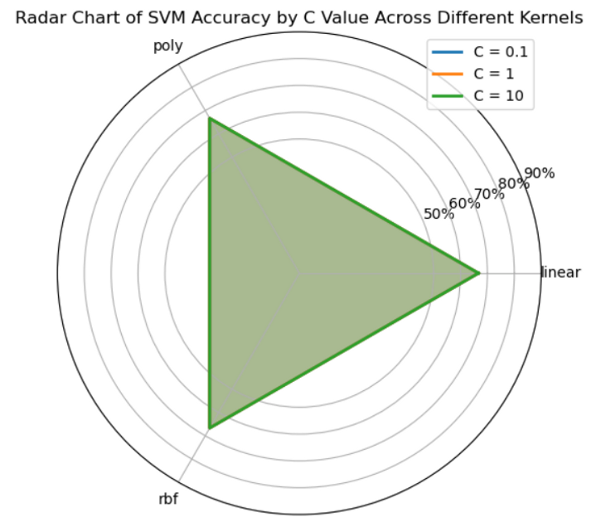

Predictive Modeling Outcomes:
The application of various machine learning algorithms, including Naive Bayes, Decision Trees, Support Vector Machines (SVM), and Neural Networks, yielded valuable insights into benzene concentration prediction. These models demonstrated varying degrees of accuracy in predicting benzene levels based on environmental factors such as traffic density, industrial activity, and meteorological conditions. For example, SVM exhibited superior performance in capturing nonlinear relationships between predictor variables and benzene concentrations, highlighting its efficacy in air quality modeling.

Slide 15
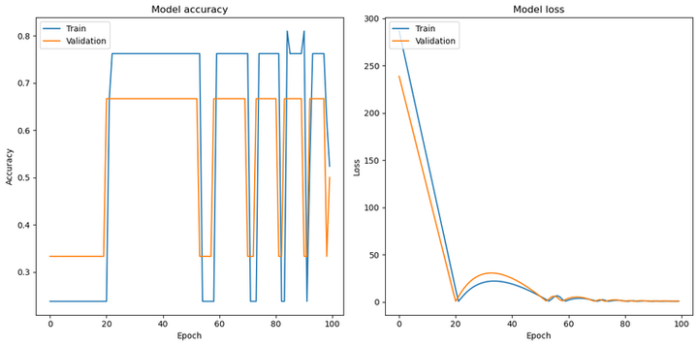
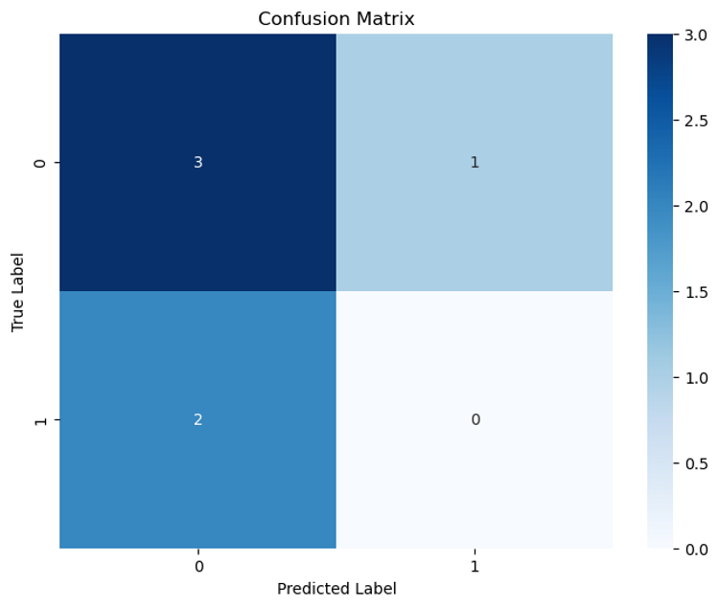

Slide 16
Temporal Trends and Variations Across Urban Areas/Benzene Concentrations:
Analysis of temporal trends revealed fluctuations in benzene concentrations over the years, reflecting changes in emission sources, regulatory interventions, and seasonal factors. Correlation analysis with geographical coordinates further elucidated the spatial-temporal dynamics of benzene pollution, highlighting hotspots of pollution activity and areas susceptible to long-term exposure risks. These findings underscore the importance of continuous monitoring and adaptive management strategies to mitigate air quality degradation and safeguard public health.
Examination of benzene levels across different urban areas uncovered disparities in environmental quality and potential inequities in exposure to air pollution. High-density urban centers exhibited elevated benzene concentrations, disproportionately impacting vulnerable communities such as low-income neighborhoods and minority populations. This disparity underscores the need for targeted interventions and policy initiatives to address environmental justice concerns and ensure equitable access to clean air resources for all residents.

Slide 17

CONCLUSION:
Insights and Strategies for Air Quality Management in North Carolina

Slide 18

Our research reveals spatial and temporal patterns in benzene levels across urban North Carolina, highlighting varying exposure risks. Targeted interventions are urgently needed to reduce air pollution and protect public health by understanding benzene emissions' sources and dynamics.
Data-driven decision-making is crucial for effectively addressing air quality challenges. Our study showcases how large-scale environmental datasets can identify trends and risk factors associated with benzene exposure, empowering policymakers to make evidence-based decisions for tangible improvements in air quality and public health.
Predictive modeling is key for guiding policy decisions and mitigating air pollution risks. Our research demonstrates the accuracy of predictive models in forecasting benzene concentrations based on environmental and meteorological factors, enabling policymakers to anticipate future trends, identify pollution hotspots, and implement targeted interventions to protect vulnerable populations.
Continued research efforts and collaborative initiatives are essential for improving air quality and safeguarding human health. Addressing air pollution requires a multi-disciplinary approach involving scientists, policymakers, healthcare professionals, and community stakeholders. By fostering collaboration and knowledge-sharing, we can advance our understanding of air quality dynamics, develop innovative solutions, and promote environmental justice for all.

Slide 19
Thank you!

